Slide 1
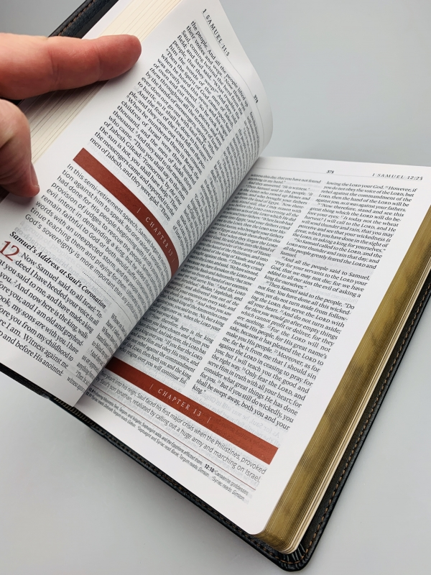
GOFAMINT NORTH AMERICA
FIVE-FOLD MINISTRY PRAYER CAMPAIGN
A RECAPITULATION
Pastor Durojaiye Ojetayo

Slide 2
TEXT
: Ephesians 4:11-14 (NKJV)
11 And He Himself gave some to be apostles, some prophets, some evangelists, and some pastors and teachers,
12 for the equipping of the saints for the work of ministry, for the edifying of the body of Christ,
13 till we all come to the unity of the faith and of the knowledge of the Son of God, to a perfect man, to the measure of the stature of the fullness of Christ;
14 that we should no longer be children, tossed to and fro and carried about with every wind of doctrine, by the trickery of men, in the cunning craftiness of deceitful plotting,

Slide 3
The aim of Christ is for His Church to become a permanent revolution for the establishment of His Kingdom on earth as it is in Heaven and bring a bumper harvest of souls into the Kingdom (Ephesians 3:20-21)
- Pastor Sunday Adu

Slide 4
NOTHING
LACKING
There is no lack in Christ because He has become our sufficiency.
2 Corinthians 3:5-6 (NKJV)
5 Not that we are sufficient of ourselves to think of anything as being from ourselves, but our sufficiency is from God,
6 who also made us sufficient as ministers of the new covenant, not of the letter but of the Spirit; for the letter kills, but the Spirit gives life.
2 Peter 1:3
as His divine power has given to us all things that pertain to life and godliness, through the knowledge of Him who called us by glory and virtue

Slide 5
The work of the Lord is not supposed to be run by human energy or wisdom. There is always enough provision for a vision born by the Spirit of God. The true Church of God is not man’s establishment. Jesus is the Lord and Master in His Church. Therefore, the Lord gave to the Church what she requires to be strong, healthy, vibrant, resourceful, powerful, and fruitful

Slide 6
THE STATE OF THE CHURCH WITHOUT THE 5-FOLD MINISTRY GIFTS IN OPERATION

Slide 7
Apostles - Govern
Prophets - Guide
Evangelists - Gather
Pastors - Guard
Teachers - Ground.
APOSTLES - Have Long Sight
PROPHETS - Have Foresight
EVANGELISTS - Have Hindsight
TEACHERS - Have Insight
PASTORS - Have Oversight
NONE OF THESE GIFTS IN OPERATION - No sight, blindness

Slide 8
When these Gifts are not in operation, the Church will be:
Revelation-less : You cannot know the things of God solely by study and reason. The revealed Will of God, helps us to discover what the Lord is saying to the Church in far greater dimensions than study. In fact, much study without revelation will sap the Minister.
Even the church in the wilderness (at least the leaders) did not lack revelation and that accounts for the surmounting of the obstacles on their way.
AND, the Church of the New Testament is now well placed to be more successful and bring down more glory.

Slide 9
2 Corinthians 3:7-10 (NKJV)
7 But if the ministry of death, written and engraved on stones, was glorious, so that the children of Israel could not look steadily at the face of Moses because of the glory of his countenance, which glory was passing away,
8 how will the ministry of the Spirit not be more glorious?
9 For if the ministry of condemnation had glory, the ministry of righteousness exceeds much more in glory.
10 For even what was made glorious had no glory in this respect, because of the glory that excels.

Slide 10
Powerless: The evidence of divine power trailed the first Church. They spoke the word powerfully, their prayers brought power, power was demonstrated as they ministered. These virtues came from the Ministry gifts that the Lord gave His Church.
Today, the power of God, demonstrated in the Church, is the only thing that will confound the wisdom of this age.
AND this is available for us in GOFAMINT NA and in all Churches.
Unholy - Guidance and guarding (the work of Prophets,Pastors and Teachers) is almost completely excluded from church today. People come and continue to do their own thing the way they seem it is right.

Slide 11
Self seeking: You cannot be in touch with Heaven and not lose yourself in God. When the Ministry gifts are in operation, there will always be a tuning to the right focus. Because the Teacher grounds us in the word of God, we are quickly corrected when we want to stray
Struggling: Struggle is not meant to be part of the Church’s experience. The combination of the gifts placed in the Church (Apostles, Prophets, Evangelists, Pastors and Teachers) when in operation, is to bring the Church to a place of dependent rest. In a way, therefore, through this prayer campaign which has also given us in-depth knowledge, God is saying to the Church to look to Him and live.

Slide 12
THE REASONS WHY THE CHURCH IS NOT WHERE IT OUGHT TO BE
The reasons are not far-fetched.
Ignorance: People don’t understand that the Church, even though has a business side, is not a Business. It is a spiritual entity; it is God’s own Establishment, it is God’s house
1 Timothy 3:15
but if I am delayed, I write so that you may know how you ought to conduct yourself in the house of God, which is the church of the living God, the pillar and ground of the truth.

Slide 13
Absence of Church Men: It has become so scarce to find men (and womb men -women) who care not for their glory but desire to see God’s glory, who care not who God chooses as Generals to lead the battle as long as they are enlisted in God’s army and are prepared to fight.
This prayer campaign and the in-depth teachings have opened our eyes that God gives these Gifts to His Church. All of us will not necessarily be Apostles or any of the other Ministry gifts ( but none of us is excluded from the gifts of the Holy Spirit and the anointing of God). However, as Church men, we must pray for the Gifts - for the Church to be where it should be.
Indifference: It does not bother many that the Church of the living God is constantly being insulted. While the insults and assaults are going on, most Church members are busy looking for God’s hands rather than beholding His face. As long as they get the crumbs, they are dangerously contented. Hence, there is no hunger, no thirst for the things of God.

Slide 14
Our God is bigger than what we are seeing. Let the Saints of God arise and stand in the porch and cry out for the Lord to return in power, distributing these Gifts to His Body so that the devil can be silenced.
Uninvested Saints: The Lord brings us out of the world and into HIS fold to have the totality of our lives. Many redeemed souls remain superficial in their commitment, offering the Lord what is convenient for them. Whereas God demands our ALL.
Deuteronomy 6:4-5 (NKJV)
4 “Hear, O Israel: The LORD our God, the LORD is one!
5 You shall love the LORD your God with all your heart, with all your soul, and with all your strength.

Slide 15
WHERE WE ARE
God has used the events of the past 4 months (July - October) to bring healing, restore understanding and lift us as a Church from the low levels so that we can stand upon our high places. We are not where we used to be. The Lord has opened our understanding regarding what belongs to us. GOD HAS GIVEN TO US WHAT WE NEED TO BECOME AND TO ACHIEVE. We can be balanced in our relationship with God, we can know God’s mind, we can understand His will, we can hear Him as He directs, we can detect the dangers on the pathway, we can overcome the antics of the devil, we are Overcomers.

Slide 16
PRAYER
1. Let us praise God profusely, who has made us (the Church) sufficient. He has given us ALL that pertains to life and Godliness.
2. Lord, we praise you specially for the Apostles, Prophets, Evangelists, Pastors and Teachers given to GOFAMINT NA and to the end time Church
3. We now pray for the emergence of these Gifts in each of the Assemblies of GOFAMINT NA, GOFAMINT globally, and the entire Church of the Living God.
4. We know that the Church is not supposed to be clueless. We pray therefore that you will remove the veil covering the eyes of your Church so that we may see clearly not only for a season but always.

Slide 17
5. There is a specific calling for every Saint in the Church. Lord I receive the grace to discover mine and to step into it.
6. The Grace of God that brings salvation also teaches us what to deny and what to embrace. (Titus 2:11). Lord! as from now, we refuse to walk in ignorance regarding the things that belong to us.
7. Through the path You have led us, Father, we believe you are setting us up for the spectacular, we therefore bind every spirit of indifference in our Church. Help us to greatly desire you and all that you have for us (Matthew 5:6)

Slide 18
8. Apostle Paul pleads that the Corinthians do not receive the grace of God in vain (2 Corinthians 6:1). We, in GOFAMINT NA, enter into the season of proof Producers. There is Divine ability to deploy the gifts that the Lord has given to us.
9. Henceforth, in our Church, we cancel out smallness. We step into the season of great harvest of souls, accompanied by great works of miracles, signs and wonders. (Jeremiah 30:19)
10. We specially speak over ALL our Assemblies. Not one will be left behind in this move of God. From our midst shall come the Nobles (Jeremiah 30:21-22)
11. Almighty God, we ask for and receive the true and right spirit as You bring us into this season (Psalms 51:10). Our motives will not be selfish but to glorify You alone and to see Your Will perfected on earth, as it is in Heaven.

Slide 19
12. Father, deliver us from every pitfall associated with the operation of these Gifts. We shall not be ensnared by mammon, pride, immorality, or any other trap set by the devil.
13. We hear the sound of abundant rain. Lord let it rain and let it flood out all ungodliness in your Church and let it prepare the ground for the bumper harvest.
14. We declare that every State in the USA is taken for Jesus. We sanctify that Jesus is Lord from the North to the South and from the East to the West. We also claim the whole of Canada and South America for Jesus.
15. We receive the grace to continue to walk in unity. There is no place for the spirit that compares themselves with themselves. (2 Corinthians 10:12) The gifts you have given will excel and You will give more (Apostles, Prophets, Evangelists, Pastors, Teachers). All of us will remain at our posts, serving you faithfully.
16. Thank you Jesus! for raising up a mighty army from GOFAMINT NA to bring defeat to Satan and his hosts.

